Slide 1
Kinetic Energy

Slide 2

By the end of this lesson you should be able to do the following:
Define kinetic energy.
Explain how work and mass influence kinetic energy.
Identify the different types of kinetic energy.

Slide 3

The most familiar type of kinetic energy is the energy used to move things from one point to another.
If you're moving, you are using kinetic energy!

Slide 4

If an object is moving quickly, it has a high kinetic energy (KE). If it is moving slowly, it will have very little kinetic energy.
Kinetic energy is also affected by mass. Heavier objects have more kinetic energy than light objects.

Slide 5

Say you have two identical dogs that you've taken to the dog park.
One dog runs off very quickly, while the other dog stays walking with you.
Which dog has more kinetic energy?
The dog that is running, because it has more speed!

Slide 6
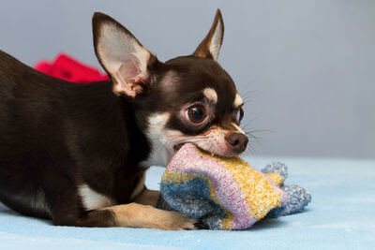
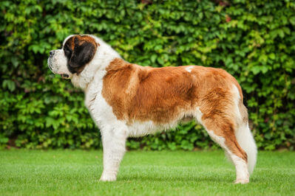
Next time you go to the dog park, you take one enormous St. Bernard and a tiny chihuahua. Both dogs run off at the same speed to go play.
Which dog has more kinetic energy?
The St. Bernard, because it has more mass!

Slide 7
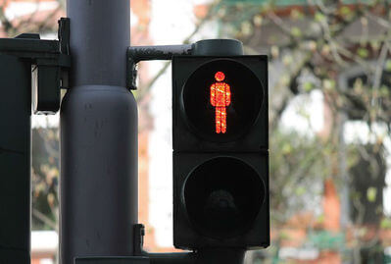
When an object is not moving, it has 0 kinetic energy (as in, no kinetic energy).
If the object is given kinetic energy through work being performed on it, it can then move!

Slide 8

A boulder on a cliffside doesn't have any kinetic energy.
If you push the boulder to the edge, you're doing work on it. This work gives the boulder kinetic energy.
It gets even more kinetic energy by falling off the cliff.

Slide 9

Any type of energy that is based on movement is a type of kinetic energy, and there are many different types!
Examples of kinetic energy are heat, sound, electrical and light.

Slide 10
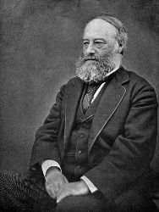
Kinetic energy is defined as the energy resulting from the movement of an object.
When associated with temperature, kinetic energy is associated with the motion of particles in a substance (symbol, E_{k​}).
The SI unit for energy is the Joule (J).

Slide 11

Heat energy is found in hot objects. Everything in the world has at least a little bit of heat energy.
Heat is classed as a type of kinetic energy, but it's not because hot things actually move around. Rather, it is the particles of hot objects that are moving!

Slide 12
The particles of a hot object vibrate in place. We can't see the vibration of these particles, but we can feel it!
Warmer particles move faster than colder particles. This means that the warmer the particles are, the more heat energy they have.

Slide 13


Slide 14
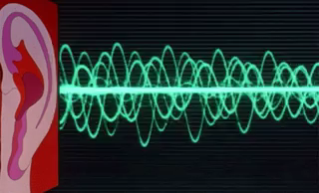
Sound energy takes a noise from a source to your ears.
Sounds are created when the air is disturbed. This disturbance takes the form of a pulse, or wave, of air. Your ears interpret this wave as a sound!
Sound is carried by vibrating and moving air. So, sound energy is also a form of kinetic energy.

Slide 15
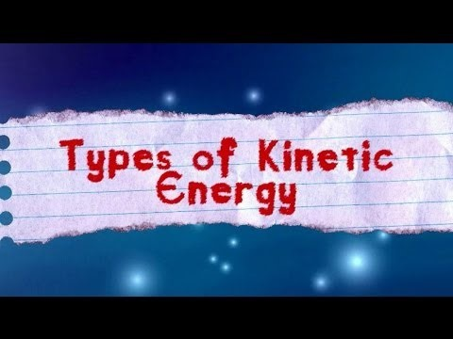

Slide 16

Light is also a form of kinetic energy, because it travels from a source until it hits your eyes. In fact, it never stops moving!
Light is a type of energy that is also known as electromagnetic radiation.
This means that it travels in straight lines, and that it can even travel through space!

Slide 17


Slide 18
When you turn on a light, it releases light energy. Where does it get the energy to make light energy from?
Electronic components get their energy from electricity! Electricity, or electrical energy, is a form of energy that moves around with the flow of tiny particles called electrons.

Slide 19

26 of 45
Processing...
Electronic circuits, like the wires in your phone charger, work by letting tiny particles called electrons move along them.
The electrons are moving so they have kinetic energy!

Slide 20
Any object can contain more than one type of kinetic energy at once.
For example, a computer is using electrical energy to power itself, is producing heat and sound energy as it runs, and makes light energy so that you can see the screen.
It does not have visible kinetic energy, however, unless you throw it out a window or something!

